Slide 1



FAIR-by-Design Methodology
Sonja Filiposka, UKIM
orcid.org/0000-0003-0034-2855

Slide 2
FAIR-by-Design Methodology
Backward Instructional Design Empowered with FAIR principles
focusing on both learners and peer instructors
Prepare
Discover
Design
Produce
Publish
Verify
Deliver
1. Do you understand FAIR and its implications?
2. Define purpose, learning objectives, target audience
1. Find existing resources
2. Identify potential for reuse
attribution
tools & formats
1. Define syllabus and structure
- facilitation materials
- granularity
2. Decide on license
1. Develop content
- compatibility
2. Define metadata
3. Internal QA check
1. Release to public
- for learners & instructors
2. Ensure accessibility
- define attribution
3. Enable feedback gathering
1. Final QA check
2. Add to training catalogue
3. Use gathered feedback for continuous improvement

Slide 3
1 - Prepare
Package of:
min 1 learning outcome
lesson plan
lesson content
min 1 activity
assessment
facilitation guide
Learn FAIR
Start Backward Instructional Design
Define:
Purpose
Target audience
Prerequisites
Scope
Formulate Learning Objectives
Define FAIR Learning Objects
Ideate
Know how to curate and share FAIR data
Have legal IPR expertise
RDA min metadata schema
Focus on the learning outcomes that one wants to achieve. Work backward to the topics that need to be covered to achieve the learning objectives
Describe what new knowledge and skills will be obtained in a specific, measurable, attainable, relevant and time-bound (SMART) way
Use the Bloom’s Taxonomy

Slide 4

The RDA Minimal Metadata for Learning Resources
Image: Minimum set of metadata for learning resources
Taken from Hoebelheinrich, Nancy J, Biernacka, Katarzyna, Brazas, Michelle, Castro, Leyla Jael, Fiore, Nicola, Hellström, Margareta, Lazzeri, Emma, Leenarts, Ellen, Martinez Lavanchy, Paula Maria, Newbold, Elizabeth, Nurnberger, Amy, Plomp, Esther, Vaira, Lucia, van Gelder, Celia W G, & Whyte, Angus. (2022). Recommendations for a minimal metadata set to aid harmonised discovery of learning resources on Zenodo licensed under CC BY 4.0

Slide 5
2 - Discover
Get Inspired!
OER
EOSC
General
Multimedia
EOSC Training catalogue on the EOSC Marketplace
Most EOSC projects have their own training catalogues and/or platforms
Creative Commons Search - content provided under a CC license
Zenodo - a multi-disciplinary open repository
OSF - a free, open platform
There is no one key to rule them all
Discovery is a lengthy, windy process
Closed learning resources have value too
DOAB
MERLOT
OASIS
OER Commons
OERTX CORA
GALILEO
FORRT
Provide for all learning modalities:
Read/write
Auditory
Visual
Kinesthetic

Slide 6
3 - Design
Create granular learning resources that can be easily reused
Mix and match while respecting licensing rules
A document that represents the trainers view and aims to enable a smooth and efficient training.
Concept
Develop
Feedback form
Facilitation Guide
Structure
Learning unit plan
Hunter’s Model
Content
Notebook
Slides
Activities
Assessment
Quiz questions
Strategy
Sketch a content concept map
Prepare a syllabus
Learners should be able to provide feedback on what worked well and what should be improved in the training and learning materials

Slide 7
HUNTER MODEL
Set learning objectives
Identify needs
Plan
Hook
Instruct
Practice
Wrap-up
Evaluate
Reflection

Slide 8
Logical organisation
Root
resources
attachments
media files
questions file
(opt) 01 Section
(opt) 01 Module
01 Learning Unit
Activities
01 activity details
...
N activity details
Assessment
question bank
(opt) strategy
attachments
media files
learning content
slide deck
learning unit plan
...
N Learning Unit
syllabus
facilitator guide
README
LICENSE
CITATION
CODE_OF_CONDUCT
Feedback

Slide 9

4 - Produce
Tools & Formats
Accessibility
Re-iterate & FInalise
Internal QA
Editable vs Final
Open file formats
Web & Multimedia friendly
Granular versioning
Collaborative environment
Straightforward conflict resolution
Cover the widest range of learner variability
w+w/o assistive technology
W3C WCAG 2.1(2.2)
PDF/UA
Use accessibility evaluation tools!
Back and forth iterations
Metadata = human + machine – readable
License
Facilitation Guide
Self-assessment
Quantitative: required elements
Qualitative: per LU

Slide 10
5 - Publish
Final preparations
To Zenodo
To LMS
Accompanying Files
Auto Workflow
For Learners
Readme
Citation
Code of conduct
Zenodo + GitHub Link
New Version Release
Approve
Add final content
Add question bank
Create quizzes
Setup feedback gathering
Add webinar room
Define badges/certificates

Slide 11
6 - Verify
FAIR-by-Design QA checklist
Required vs optional
Review w/o cognitive bias
From a new learner perspective
Setup gathering from both perspectives
QA checklist
Level of FAIRness
External QA
LMS QA
Feedback QA

Slide 12





Continuous Improvement
GitHub issues
Fork and pull requests
Direct mail contact
Other means of communication
Select items from the list that will be part of a new version
2017
Internal
External
Analyse
Improve
Repeat
feedback form
QA recommendations
self-reflection after training
Create a list of potential improvements with impact level (high, moderate, low)
Start a new cycle of the FAIR-by-Design methodology

Slide 13
FAIR-by-Design Methodology How-Tos
Up-to-Date Methodology
https://fair-by-design-methodology.github.io/FAIR-by-Design_Book/
ToT course on Skills4EOSC LMS
https://learning.skills4eosc.eu/course/view.php?id=19
Training GitBook
https://fair-by-design-methodology.github.io/FAIR-by-Design_ToT/latest/
GitHub
https://github.com/FAIR-by-Design-Methodology/FAIR-by-Design_ToT
Templates GitHub repo
https://github.com/FAIR-by-Design-Methodology/templates

Slide 14
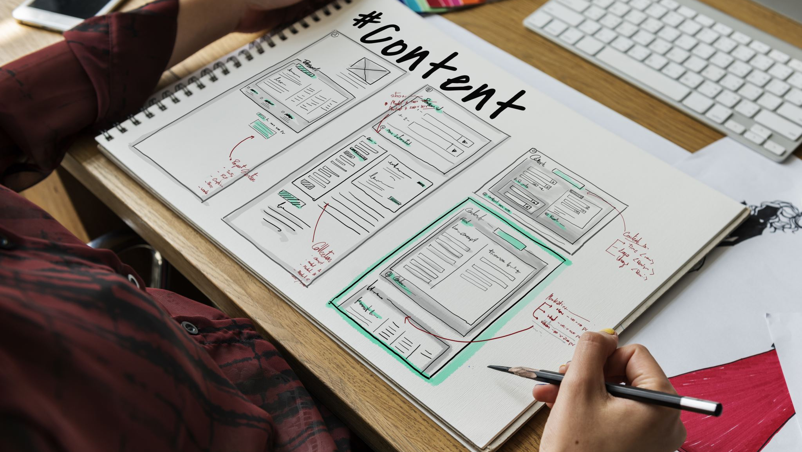
What about FAIR software objects?
Be FAIR…reuse the FAIR-by-Design Methodology…

Slide 15
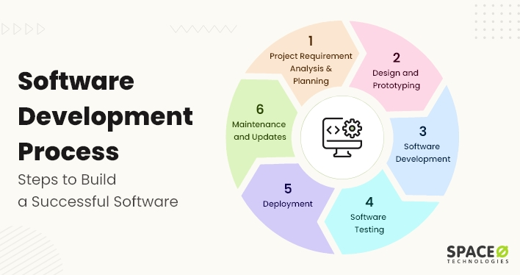

Slide 16
FAIR-by-Design Methodology Learning materials -> Research software
Software Development Process empowered with FAIR principles
Prepare
Discover
Design
Produce
Publish
Verify
Improve
1. Do you understand FAIR and its implications?
2. Gather requirements, define goals
1. Find existing libraries/modules
2. Identify potential for reuse
attribution
compatibility
1. Define structure
- granularity
2. Decide on license
1. Develop code
2. Define metadata
3. Test
1. Release to public
2. Define attribution
3. Ensure feedback gathering
1. Final QA
2. Add to SWH catalogue
3. Start maintaining

Slide 17
1 – Prepare (Requirement analysis and resource planning)
Research Software includes source code files, algorithms, scripts, computational workflows and executables created during the research process or for a research purpose
Learn FAIR
Start Software Development Process
Perform requirements analysis
Define project scope
Formulate Software Development Plan
Define FAIR Software Objects
Ideate
Know how to curate and share FAIR data
Have legal IPR expertise
Identify research software metadata
Aim to produce high-quality software that meets the the requirements and constraints
Allocate resources for the software development process

Slide 18

Metadata for Research Software
D4.4 - Guidelines for recommended metadata standard for research software within EOSC

Slide 19
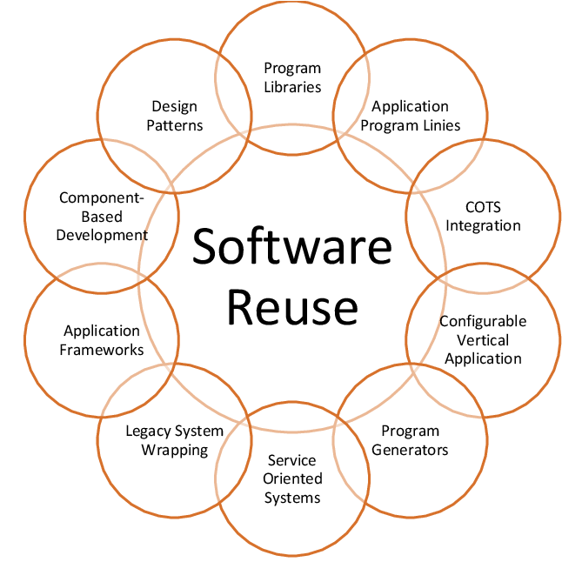
2 – Discover (Software Reuse)
System reuse
building a system of systems
Application reuse +
adaption of a software system to address different needs
Component-based reuse ++
repository of common atomic components used to build a new software system
Object and Function reuse +++
Software components that execute a specific task
Functional and class standard libraries
Software Reuse Development frameworks, taken from: Anasuodei, Moko et al. “Software Reusability: Approaches and Challenges.” (2021), https://api.semanticscholar.org/CorpusID:237320187

Slide 20
3 – Design (Software architecture)
Define the software architecture
Mix and match software elements while respecting licensing rules
The quality attributes
Usability, security, …
Other requirements
Concept
Develop
Structure
Non-functional requirements
Sketch a concept map
Used to define the ontology of the software solution
High-level view
Create a Prototype to test the ideas
Performance, scalability, portability, extensibility, compliance

Slide 21
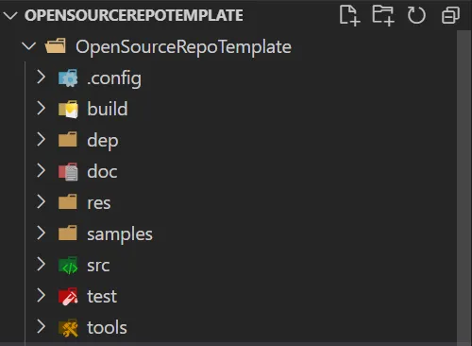
Logical organisation
GitHub Repository Structure Best Practices
Available at:
https://github.com/CodeFactoryBerlin/OpenSourceRepoTemplate

Slide 22

4 – Produce (Develop and Test)
Develop
Documentation
Re-iterate & Finalise
Initial QA - Test
Use recommended best practices
Practice branching
Follow naming conventions
Manifesto for Agile software development
Follow best practices for creating software documentation
Use conventional commits
Back and forth iterations
Per file Metadata = human + machine – readable
Semantic Versioning
Develop test cases
Use different types of software tests
Fix bugs and errors

Slide 23
5 – Publish (Deploy Release)
Final preparations
To Zenodo
To Catalog
Special Files
Workflow
Preserve
README
LICENSE
CHANGELOG
CONTRIBUTORS
AUTHORS
SUPPORT
CITATION
CODE_OF_CONDUCT
ACKNOWLEDGEMENT
…
Zenodo + GitHub Link
New Version Release
Archive research software on Software Heritage
https://www.softwareheritage.org/

Slide 24
6 – Verify (FAIR assessment)
FAIR research software
Required vs optional
Review w/o cognitive bias
Enable feedback gathering
D5.2 - Metrics for automated FAIR software assessment in a disciplinary context
QA checklist
Level of FAIRness
External QA
Feedback QA

Slide 25
Continuous Improvement
GitHub issues
Fork and pull requests
Direct mail contact
Other means of communication
Select items from the list that will be part of a new version
2017
Internal
External
Analyse
Improve
Repeat
Backlog
QA recommendations
self-reflection
Create a list of potential improvements with impact level (high, moderate, low)
Start a new cycle of the FAIR-by-Design methodology

Slide 26

Help us improve
We are very interested in your thoughts and ideas
Let us co-create and make a new, improved, version of the FAIR-by-Design materials together
Give us feedback on the training
Fill out the FAIR-by-Design methodology survey form available at https://zenodo.org/records/8305540

Slide 27


Thank you! Questions? Credit: Some of the slides in this presentation were created by SlideEgg
Cite instructions on: https://doi.org/10.5281/zenodo.10676532
Filiposka, Sonja. (2024, February 19). FAIR-by-Design Methodology. FAIR-by-Design Workshop. IDCC’24. Zenodo

